Slide 1
Employee Attrition Analysis
Ani Laliashvili

Slide 2
Goal
To predict the probability of retirement and resignation of employees in the next 10 years based on their age, length of service and gender

Slide 3
Data
49,653 records from 6,284 employees
Fictitious global retail chain
10 years: 2006-2015
Excludes employee records after/if contract is terminated
High quality data with no missing values

Slide 4
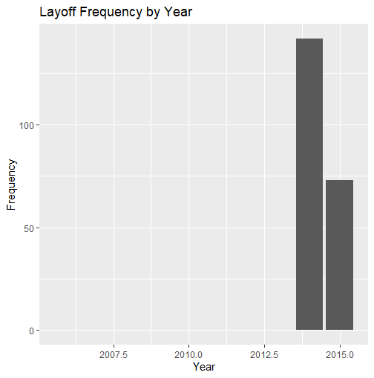
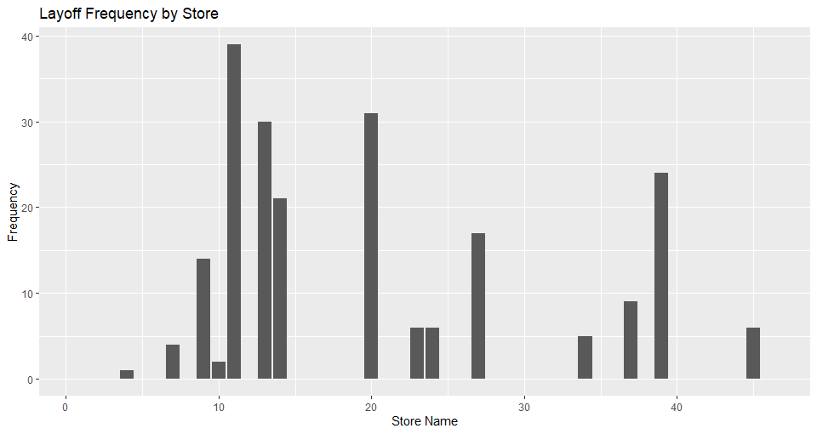

Termination Statistics
Notes:
215 employees have been laid off
layoffs occurred only in 2013-2014
385 have resigned
885 have retired

Slide 5
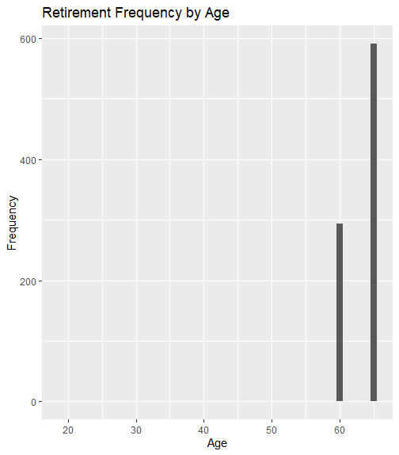
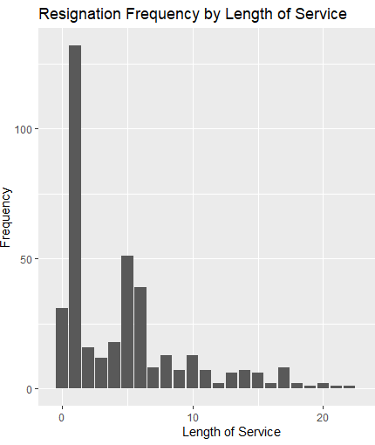
Predictor Variables
Length of service
Age
Gender

Slide 6
Workflow
.7 Division of Training/Scoring data
Rank Order Model
Validation Plots + Visualizations
Assign Cubic Splines
Survival Functions
Forecasts
Feature Engineering
Forecast Visualizations

Slide 7
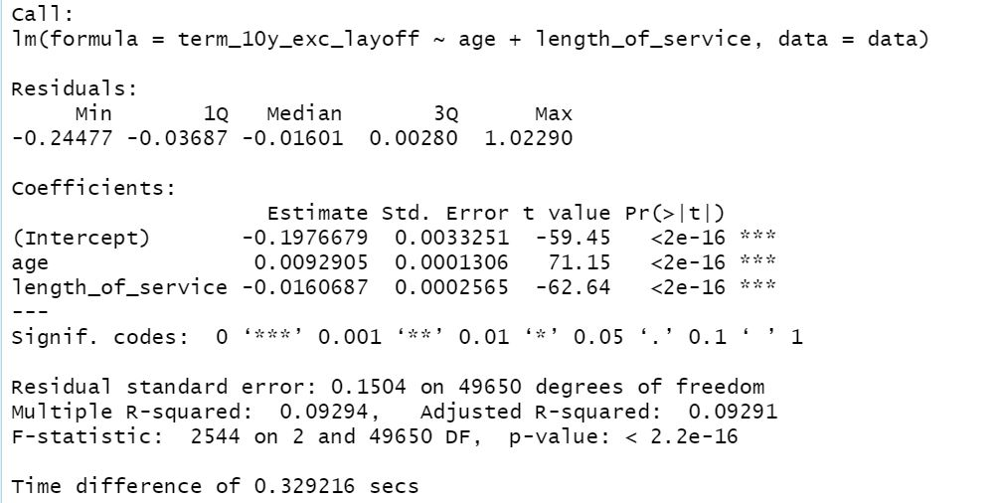
Stepwise Variable Selection Results

Slide 8
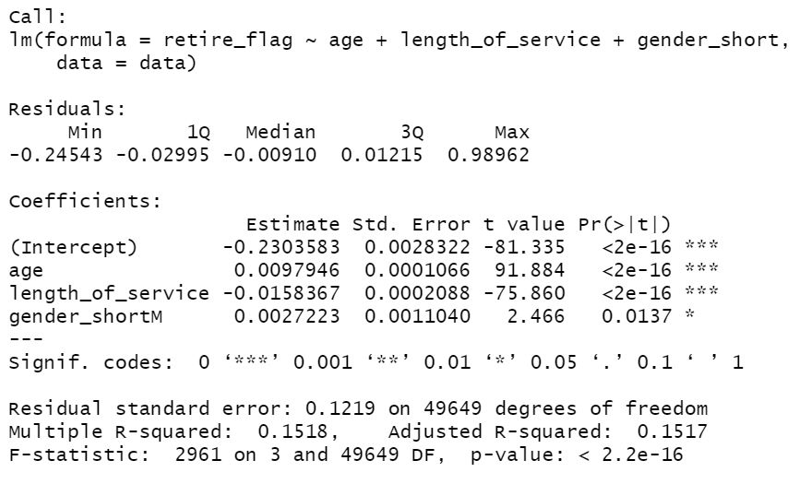
Retirement Model Variable Selection Result

Slide 9
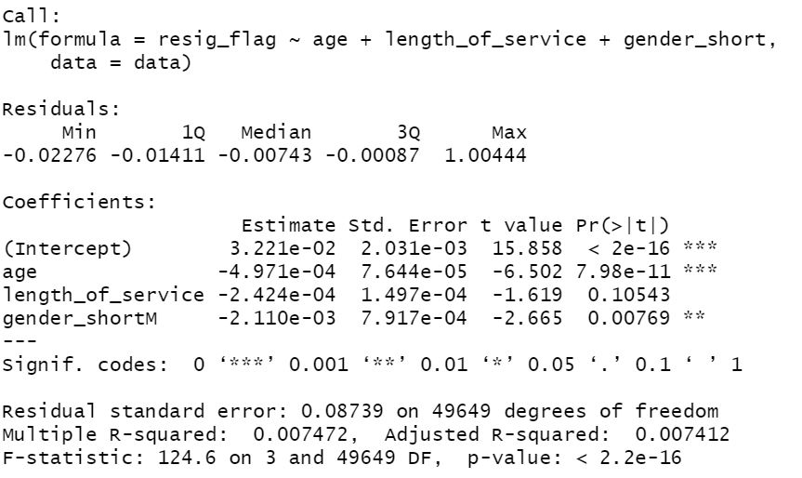
Resignation Model Variable Selection Result

Slide 10
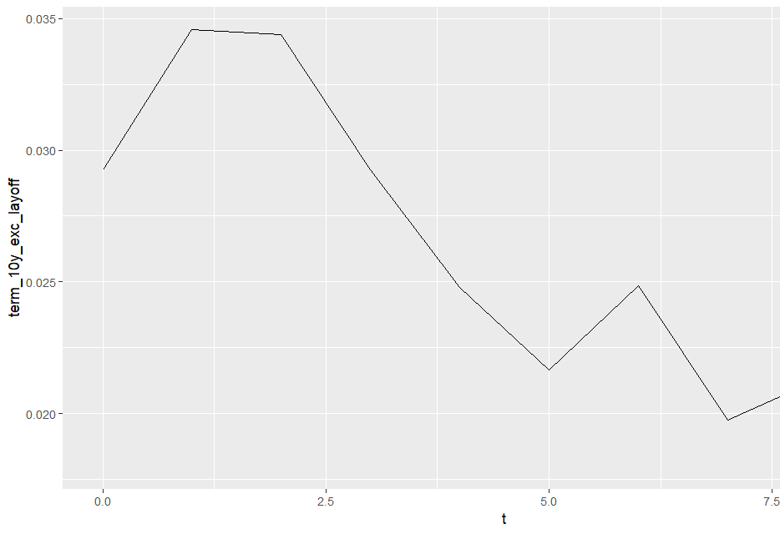
Resignations and Retirements over Time

Slide 11
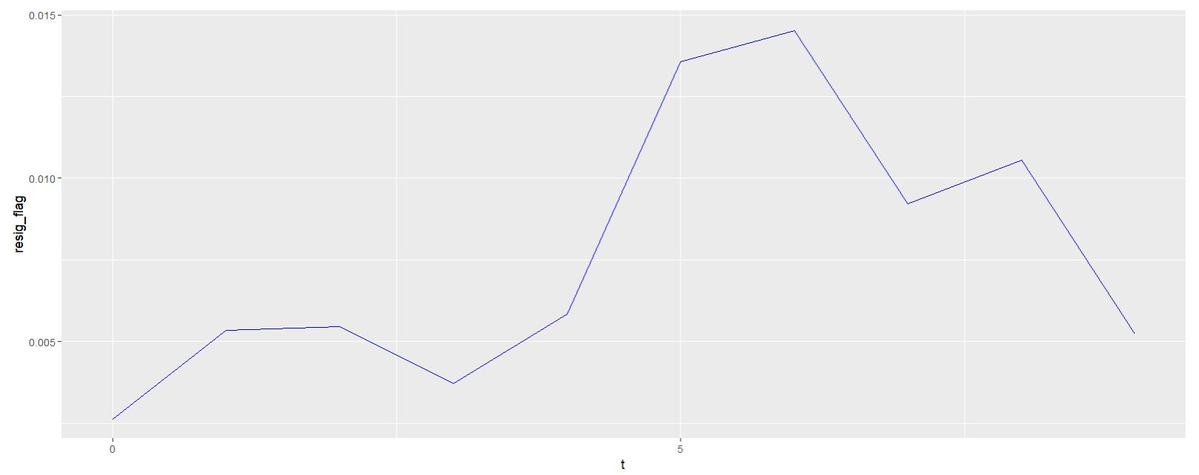
Resignations Over Time

Slide 12
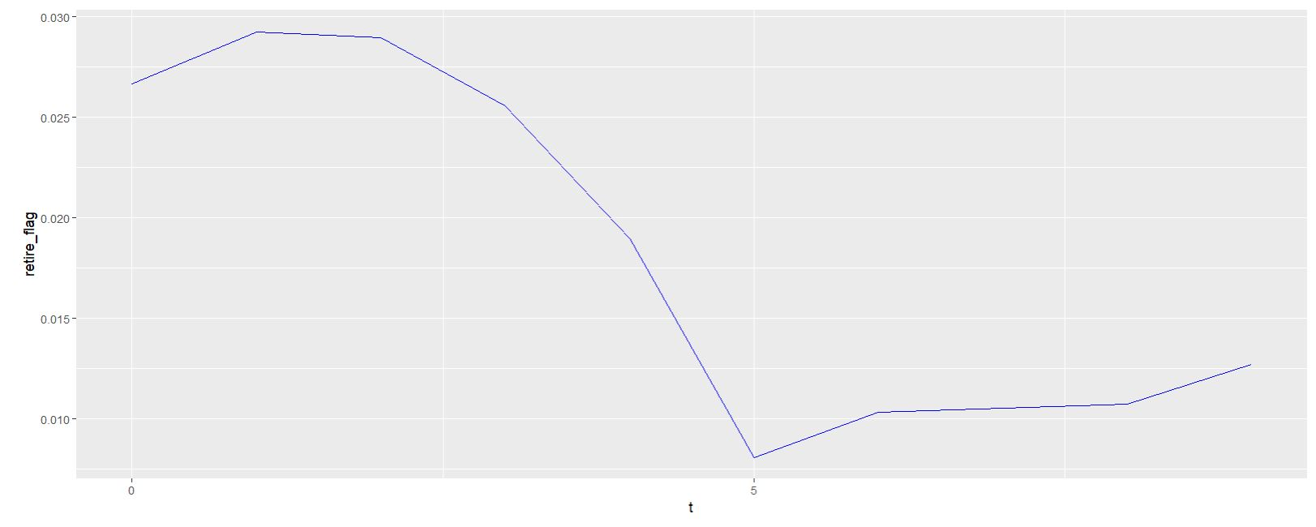
Retirements Over Time

Slide 13
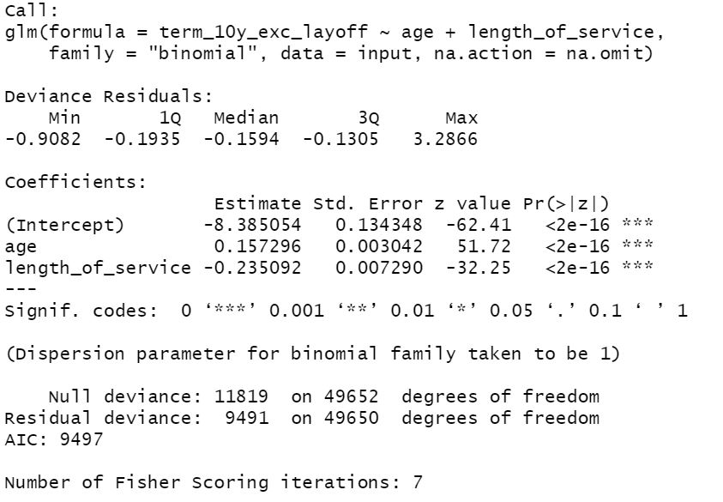
Aggregate Rank Ordering Risk Model

Slide 14
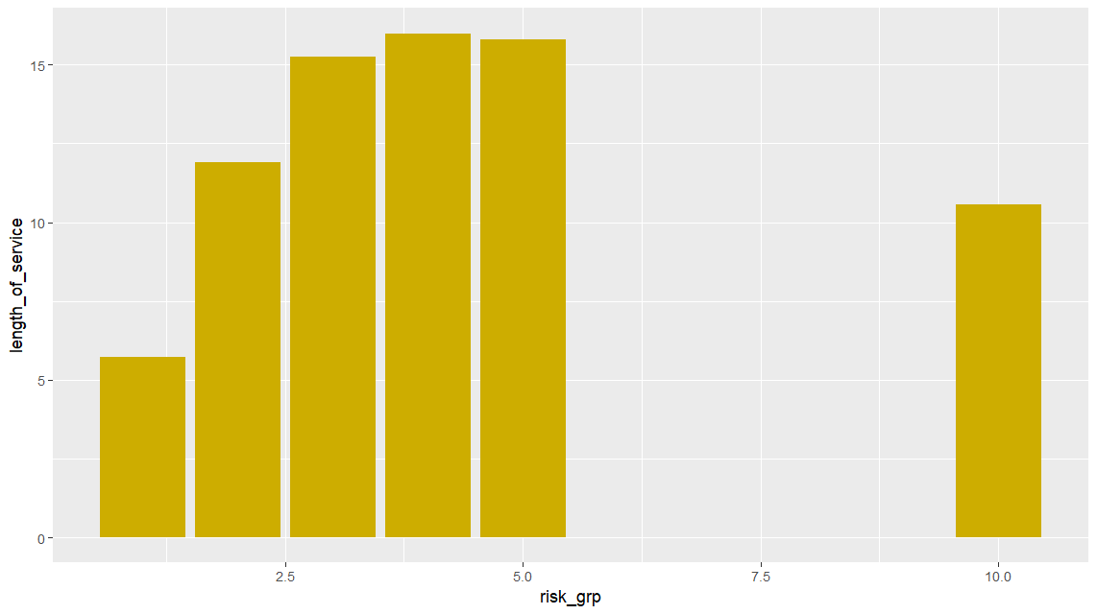

Slide 15
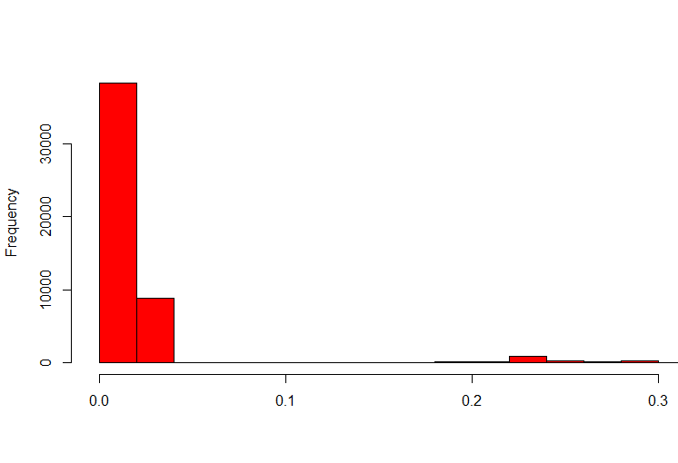
Termination Probability Distribution Excluding Layoff

Slide 16
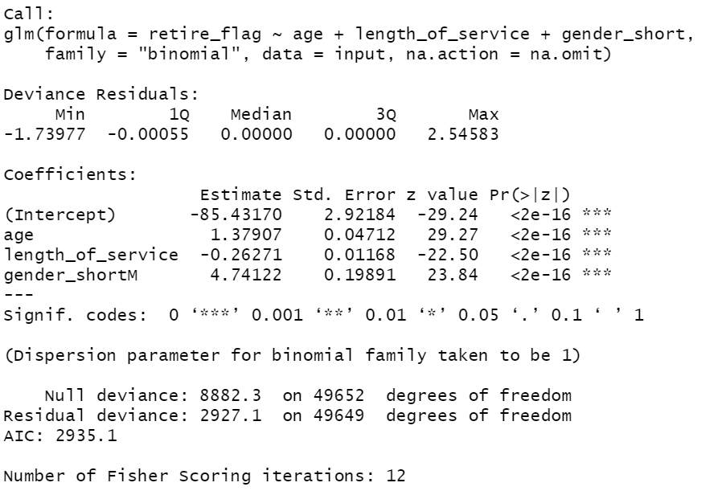
Retirement Rank Ordering Risk Model Output

Slide 17
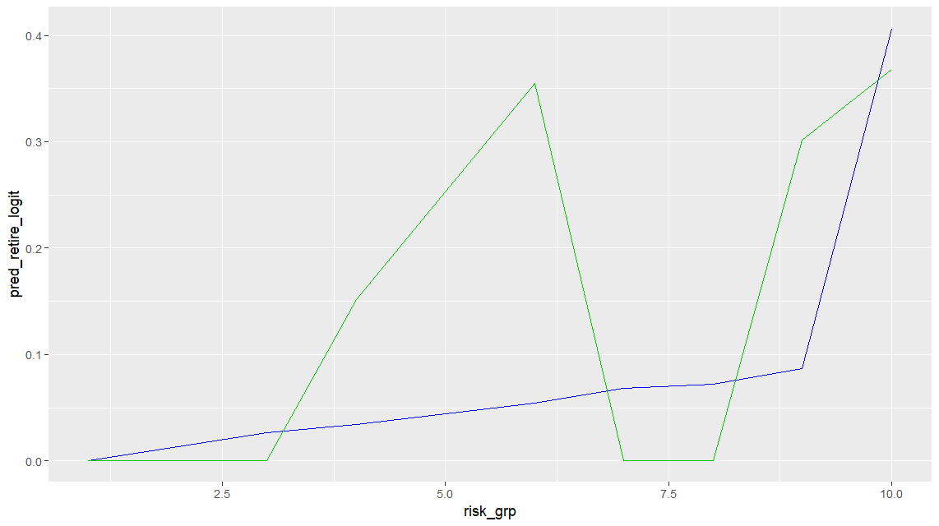
Retirement Rank Ordering Risk Validation Plot

Slide 18
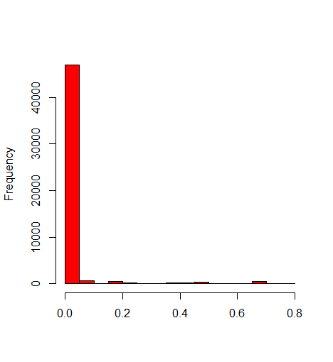
Retirement Probability Frequency Distribution

Slide 19
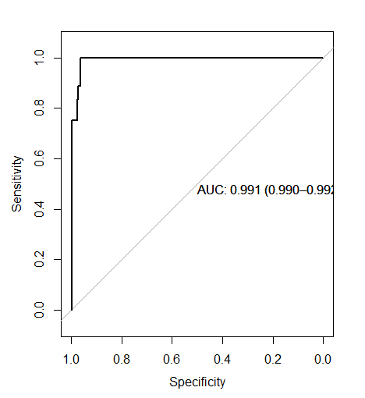
Retirement ROC Curve

Slide 20
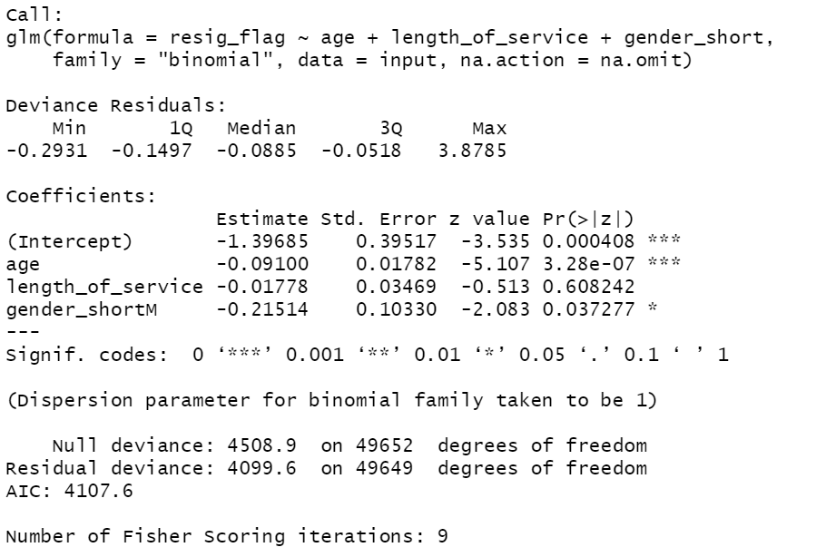
Resignation Rank Ordering Risk Model Output

Slide 21
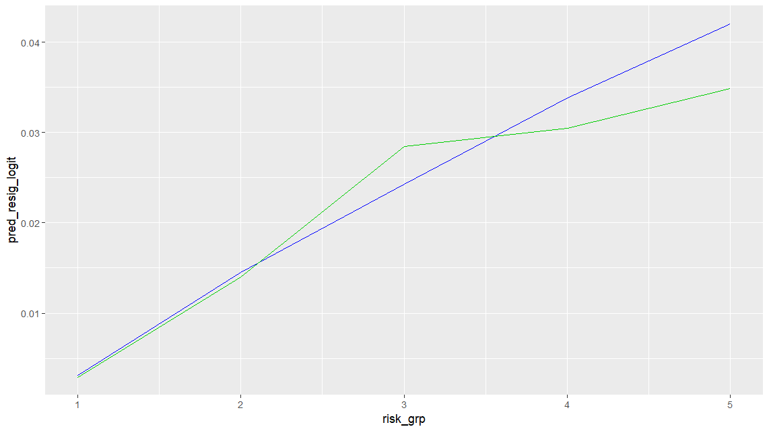
Resignation Validation Plot

Slide 22
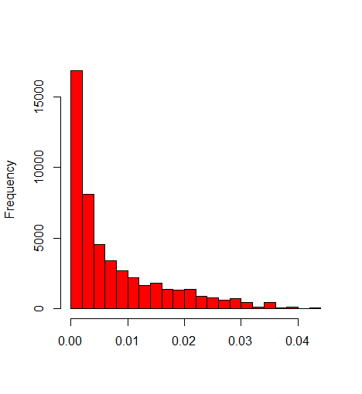
Resignation Probability Frequency Distribution

Slide 23
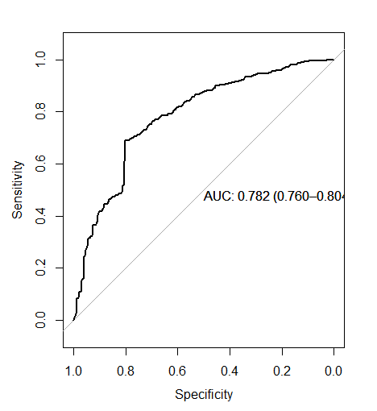
Resignation ROC Curve

Slide 24
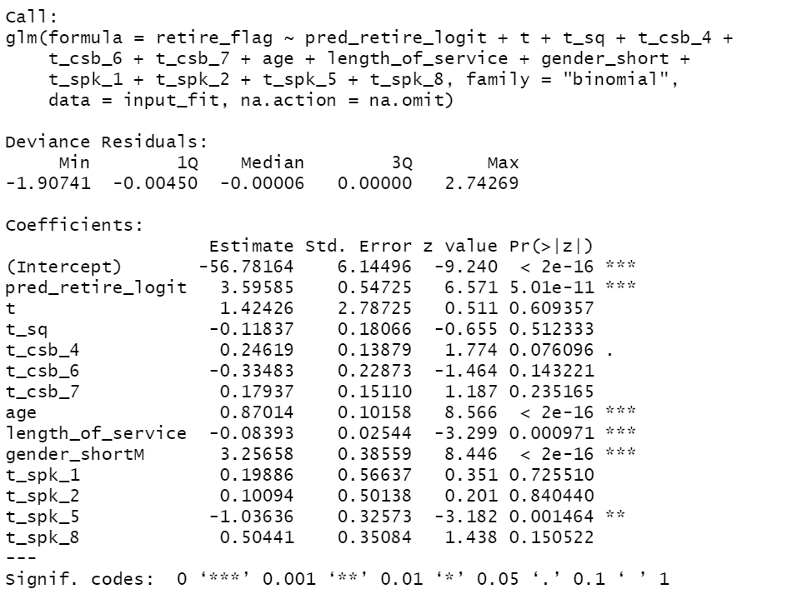
Retirement Survival Function Output

Slide 25
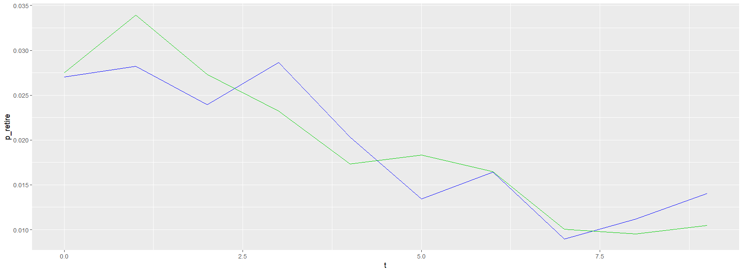
Predicted Retirement Probabilities

Slide 26
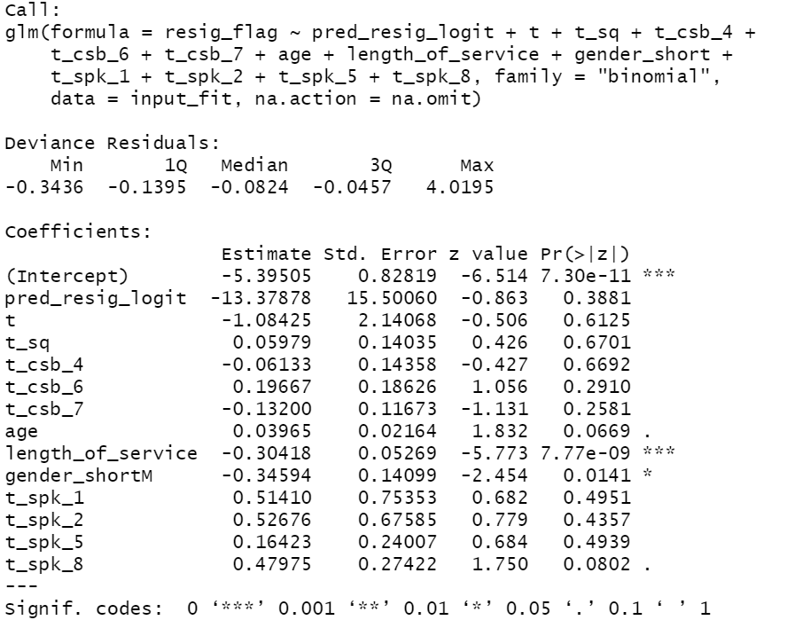
Resignation Survival Function Output

Slide 27
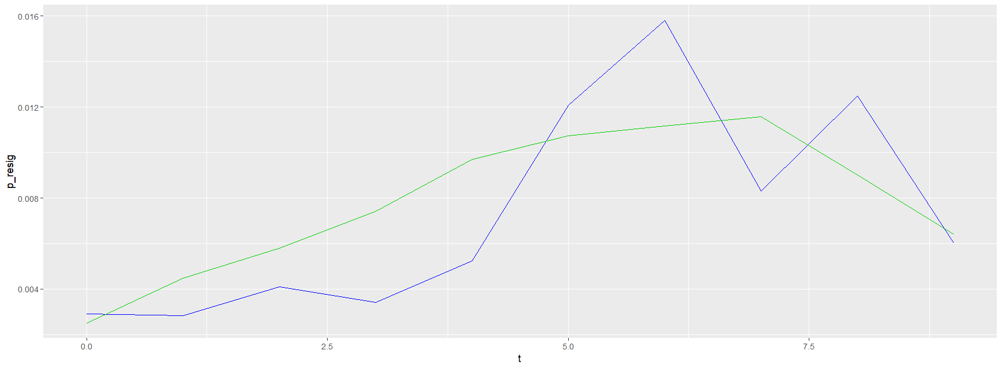
Predicted Resignation Probabilities

Slide 28
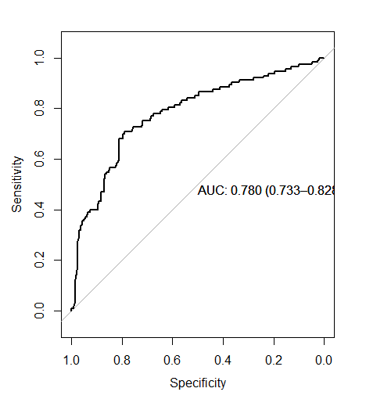
Resignation ROC Curve

Slide 29
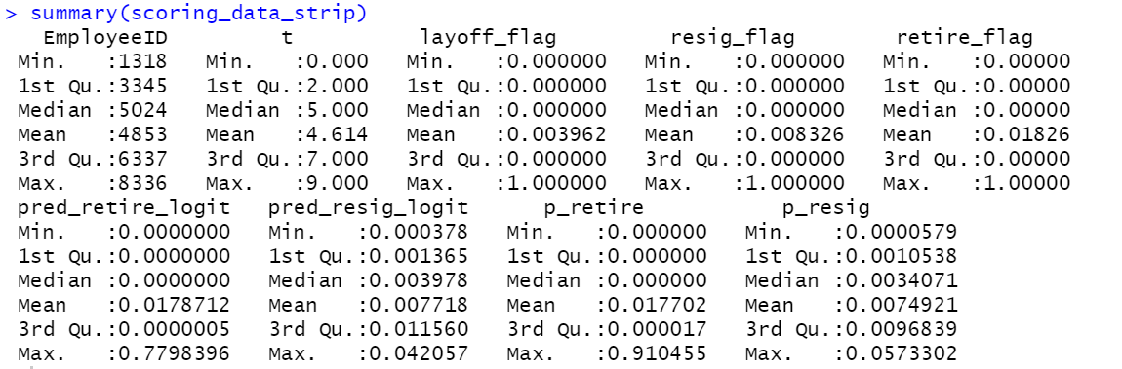

Slide 30
Questions&Comments

Slide 31
Thank you!

